Slide 1
Proof of Concept
By
MARGARET MUMBI GICHUHI

Slide 2
Problem Statement
Employee attrition control
OBJECTIVE
explain the reasons employees are prone to leave after analyzing this data set.
2.explain what type of employee are prone to leave the company.
3.predict the future employee who would tend to leave the company
The data is for company X which is trying to control attrition. There are two sets of data: "Existing employees" and "Employees who have left". Following attributes are available for every employee.
Satisfaction Level
Last evaluation
Number of projects
Average monthly hours
Time spent at the company
Whether they have had a work accident
Whether they have had a promotion in the last 5 years
Departments (column sales)
Salary
Whether the employee has left

Slide 3
APPROACHES
Observation - describe the data about customer attrition that will help in shaping various hypothesis and determining the characteristics of data.
Visualization – Data visualization for developing and testing the hypothesis.
Prediction – Predict employees prone to leave.

Slide 4
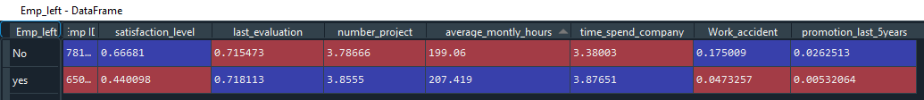
OBSERVATIONS
Compare the characteristics of the existing employees and the employees who left by finding the average of the two groups.
From the above statistics, the following conclusions can be made
The employees who left have:
low satisfaction level
Low promotion rate
More working hours

Slide 5
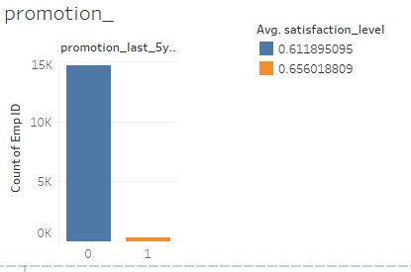
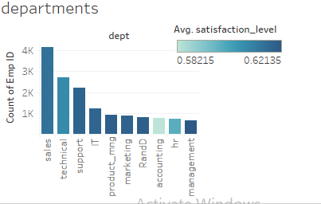
Data Visualization
Using tableau for visualization, and using satisfaction level as the key element that contributes to attrition of employees, various observations are made.

Slide 6
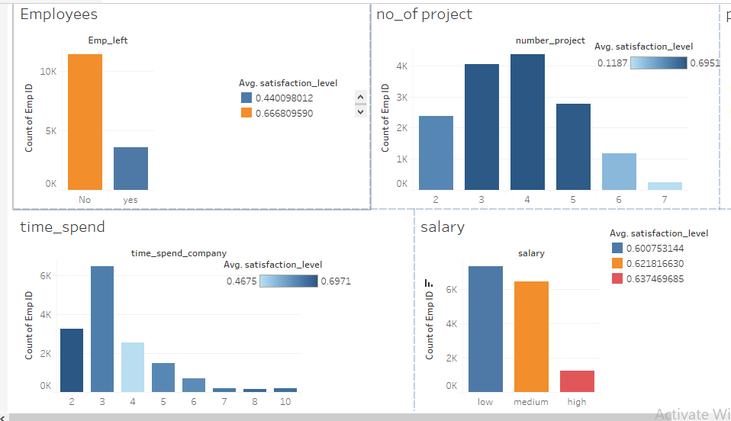

Slide 7
Observations from the above visualizations
Very few employees are promoted in the last 5 years and those promoted have a high satisfaction level.
Employees with 5 or more projects are less satisfied.
Most employees have low and medium salaries.
There are more employees in the sales department followed by technical then support.
Employees in the accounting department are least satisfied.
There is a significant difference between employees who have worked in the company for 3 years and the employees who have worked for 4 years in the company.
Most employees leave because they are not satisfied with their jobs. Time spent at the company, number of projects are some of the attributes affecting employee job satisfaction.
Analysis on the various factors contributing to employees attrition

Slide 8
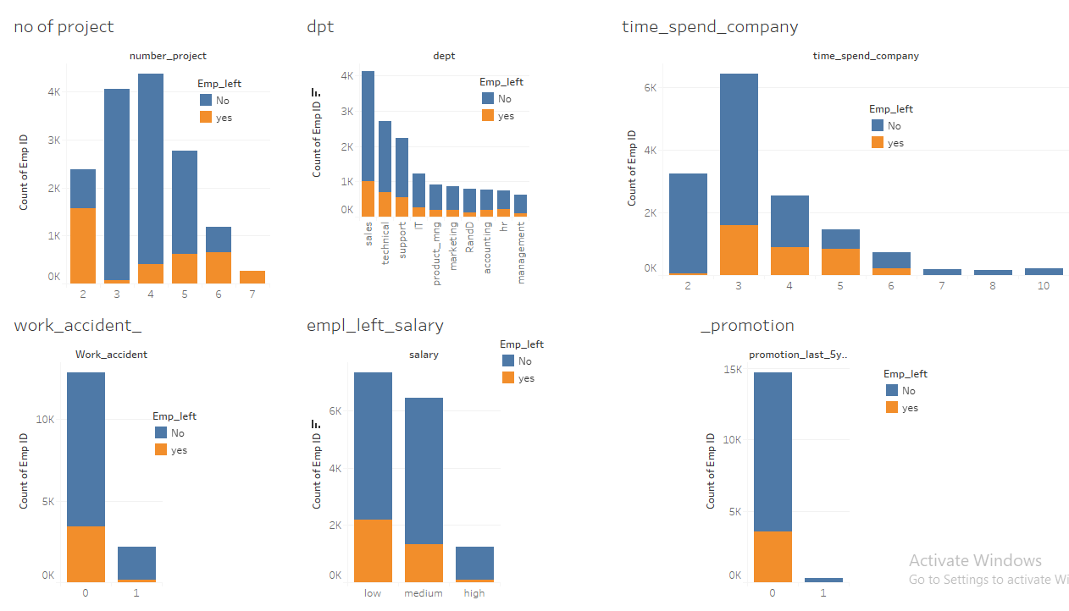

Slide 9
observations
Employees with more than 5 and less than 3 projects are likely to leave the company.
Since sales department has the most number of employees, it also has the most number of employees who left.
Employees leaving the company with 5 or 6 years spend at the company are the ones who have not been promoted in the last 5 years whereas employees with more than 7 years in the company are less likely to leave. Most employees start to leave at the 3 year mark.
Most Employees with low and medium salaries have left.
Work accident is the least factor causing employees to leave For most employees who have left have not experienced work accident.

Slide 10
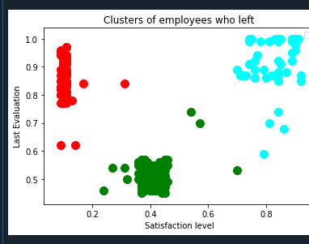
Cluster Analysis
Blue – Represents employees who have high evaluation and high satisfaction level. Leaving of these employees may cause a negative impact on a company.
Red – Represents employees with high evaluation and low satisfaction level. These are employees who are aggravated.
Green – Represents employees with moderate satisfaction level and moderation evaluation.

Slide 11
Prediction Analysis
Create a machine learning model using random forest algorithm to predict the existing employees who are prone to leave.
Process
Import dataset
Split dataset
Fit random forest classification to dataset
Predict test results
Why use Random Forest classification model?
Random Forest classification is an ensemble learning model that uses multiple learning models to gain better predictive results thus have a higher accuracy rate compared to other models.

Slide 12
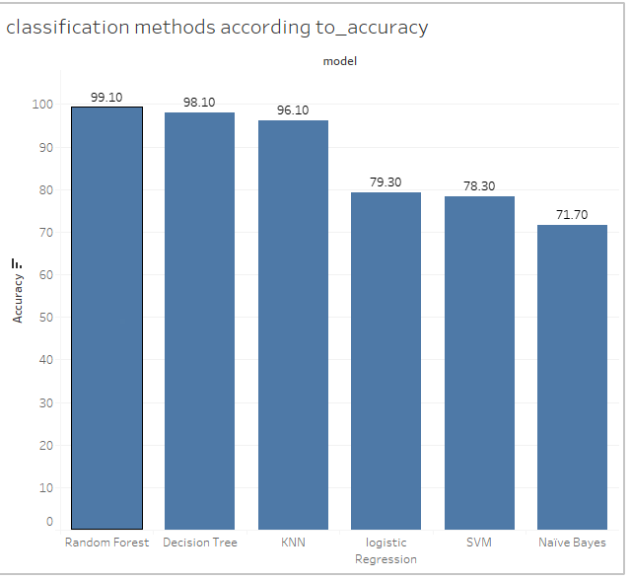

Slide 13
Data prediction process
Importing data
70%
Labeling dataset
30%
Train data
Test data
Train classifier
Feed test data to trained classifier
Trained classifier algorithm
prediction

Slide 14
Conclusion
Types of employees leaving
Employees with less than 3 projects and more than 5 projects.
Employees with low and medium salaries.
Time with Company: The three-year is a crucial point in an employee's career. Most of them leave at around the three-year mark. Another important point is 6-years point, where the employee is very unlikely to leave.
Employees who have spent 5 or six years in the company without a promotion in the last 5 years.

Slide 15
Conclusion…cont
Employees prone to leave next
Employees who have worked for 5 or 6 years in the company and have not been promoted yet.
Employees who work on two projects or more than 5 projects.
Employees with low and medium salaries.
Employees at their third year in the company and their satisfaction level is decreasing significantly.

